Slide 1

18CSE392T – Machine Learning I
Department of Data Science and Business Systems

Slide 2
classification

Slide 3
Definition
Classification is a task that makes use of machine learning algorithms that learns how to assign a class label to the data.

Slide 4
Types of Classification
Classification Predictive Modeling
Binary Classification
Multi-Class Classification
Multi-Label Classification
Imbalanced Classification

Slide 5
Classification Predictive Modeling
Classification refers to a predictive modeling problem where a class label is predicted for a given example of input data.

Slide 6
Binary Classification
Binary classification refers to those classification tasks that have two class labels.
Examples include:
Email spam detection (spam or not).
Churn prediction (churn or not).

Slide 7
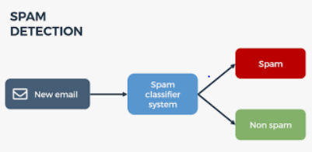
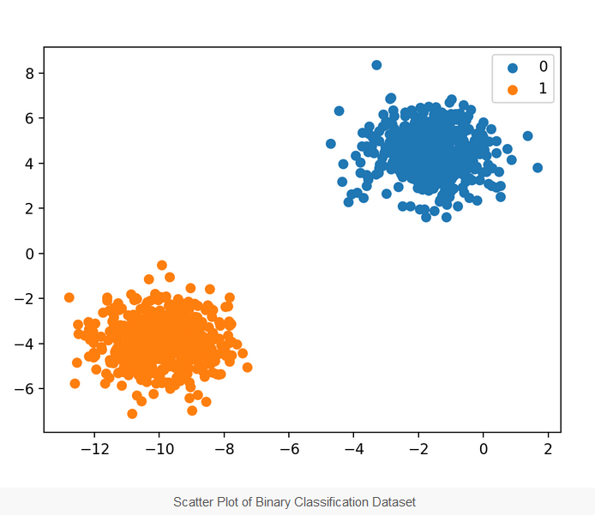

Slide 8

Multi-class classification
Multi-class classification refers to those classification tasks that have more than two class labels.
Examples include:
Face classification.
Plant species classification.

Slide 9
Multi-label classification
Multi-label classification refers to those classification tasks that have two or more class labels, where one or more class labels may be predicted for each example.
Consider the example of photo classification, where a given photo may have multiple objects in the scene and a model may predict the presence of multiple known objects in the photo, such as “bicycle,” “apple,” “person,” etc.
This is unlike binary classification and multi-class classification, where a single class label is predicted for each example.

Slide 11
Imbalanced Classification
Imbalanced Classification refers to classification tasks where the number of examples in each class is unequally distributed.
Mostly, imbalanced classification tasks are binary classification tasks where the majority of examples in the training dataset belong to the normal class and a minority of examples belong to the abnormal class.
Example - Fraud detection, Outlier detection.

Slide 12


